Slide 1
CSI3344 Distributed Systems
Lecture 4:
Communication (2)
  4.1 Remote Procedure Call (RPC)
  4.2 Remote Method Invocation (RMI)
  4.3 Communication Systems
Major Points
Reading Guide
Distributed Systems
CSI3344

Slide 2
Objectives
Be familiar with the principles of RPC;
Describe the procedure of making a RPC;
Be familiar with various RPC models and their characteristics;
Be familiar with the general structure of RMI;
Describe the procedure of making a RMI;
Be aware of classification of message-queuing systems.
Distributed Systems
CSI3344

Slide 3
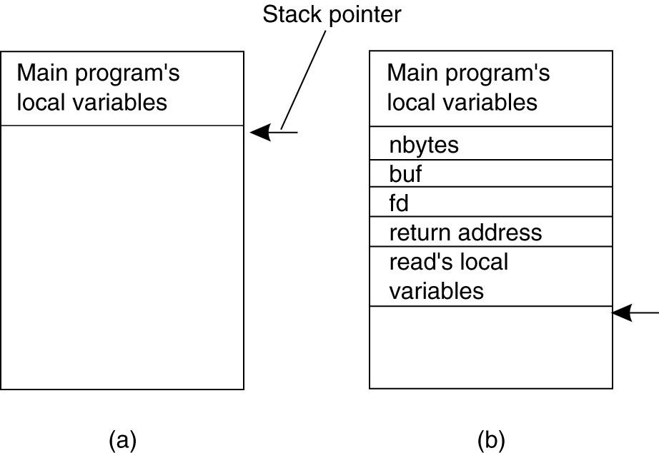
4.1 Remote Procedure Calls (1)
Conventional Procedure Call in C
  Parameter passing in a local procedure call: the stack before the call to read.
  The stack while the called procedure is active.
Distributed Systems
CSI3344

Slide 4
4.1 Remote Procedure Calls (2)
What is RPC?
  When a process on (client) machine A calls a procedure on (server) machine B, the calling process on A is suspended, and execution of the called procedure takes place on B.
  Information can be transported from the caller to callee in the parameters and can come back in the procedure result.
  Programmers cannot see message passing at all - transparency.
  RPC is supported by middleware communication services.
  RPC was initially implemented using C.
Distributed Systems
CSI3344

Slide 5
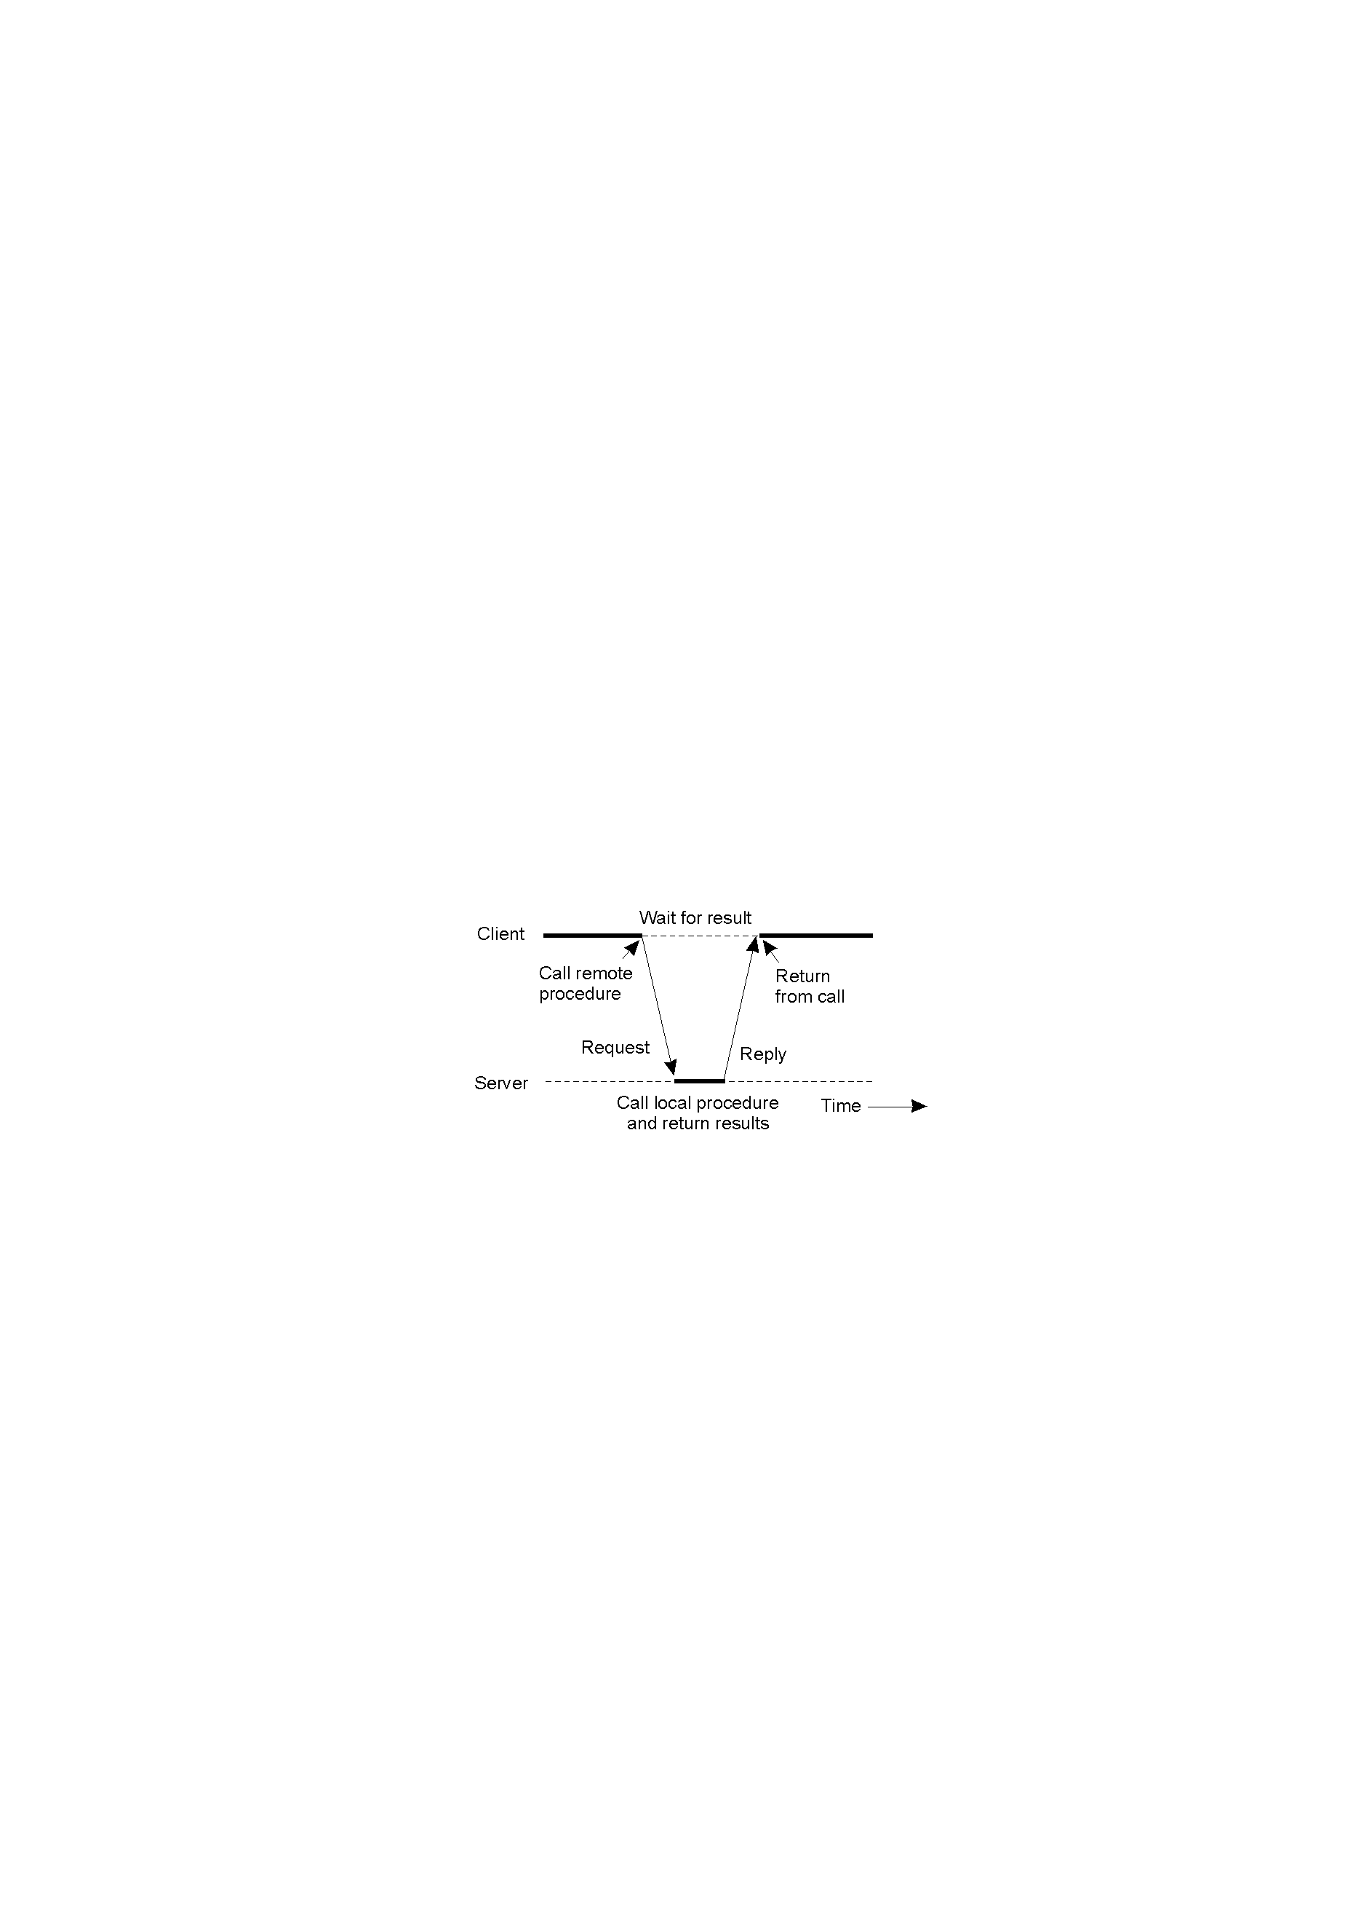
4.1 Remote Procedure Calls (3)
* Principle of RPC between a client and server
Distributed Systems
CSI3344

Slide 6
4.1 Remote Procedure Calls (4)
  Some terms:
  A stub is a small chunk of C code that is compiled and linked into the client and server programs.
  Client stub:
    converts parameters into a message (i.e., a string of bits) and sends the message over the network.
  Server stub:
    takes the message, converts it back into parameters, and then calls the local procedure at the server side.
  Parameter marshaling: Packing parameters into a message.
Distributed Systems
CSI3344

Slide 7
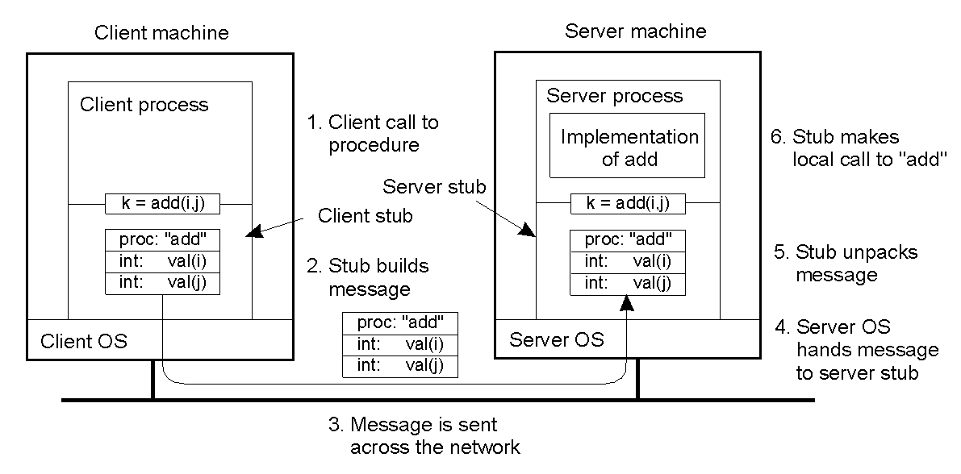
4.1 Remote Procedure Calls (5)
General structure of RPC
Distributed Systems
CSI3344

Slide 8
4.1 Remote Procedure Calls (6)
A RPC occurs in the following steps:
  The client procedure calls the client stub in the normal way.
  The client stub builds a message and calls the local operating system.
  The client’s OS sends the message to the remote OS.
  The remote OS gives the message to the server stub.
  The server stub unpacks the parameters and calls the server.
  (Continue to next slide …)
Distributed Systems
CSI3344

Slide 9
4.1 Remote Procedure Calls (7)
A RPC occurs in the following steps (continued):
  The server does the work and returns the result to
  the server stub.
  The server stub packs it in a message and calls its
  local OS.
  The server’s OS sends the message back to the
  client’s OS.
  The client’s OS gives the message to the client stub.
  The stub unpacks the result and returns to the client.
Distributed Systems
CSI3344

Slide 10
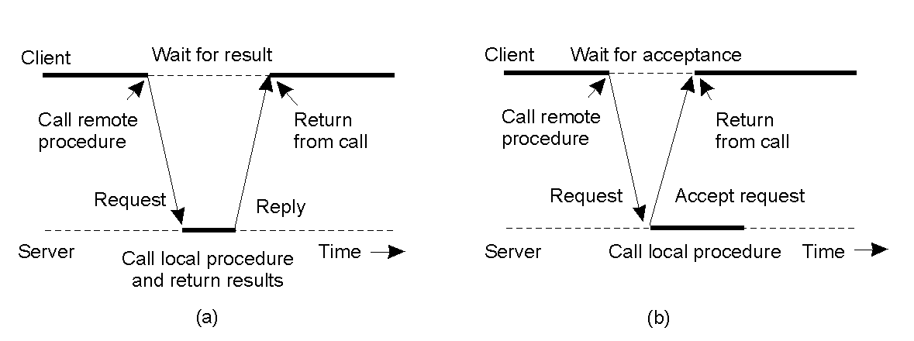
4.1 Remote Procedure Calls (8)
  Asynchronous RPC
2-12
(a) Traditional RPC (b) Asynchronous RPC
Distributed Systems
CSI3344

Slide 11
4.1 Remote Procedure Calls (9)
Asynchronous RPC
  Client sends a request to server.
  Server sends back a reply immediately (as an acknowledgement) after receiving the request, and then starts processing the request.
  Client starts doing new work without further blocking after receiving the server’s reply.
  Asynchronous RPC is useful when there is no result to return from the server (e.g., transferring money from one account to another, adding new entries to a database, etc.).
  Question: in Asynchronous RPC, how and when
  the server sends results to the client?
Distributed Systems
CSI3344

Slide 12
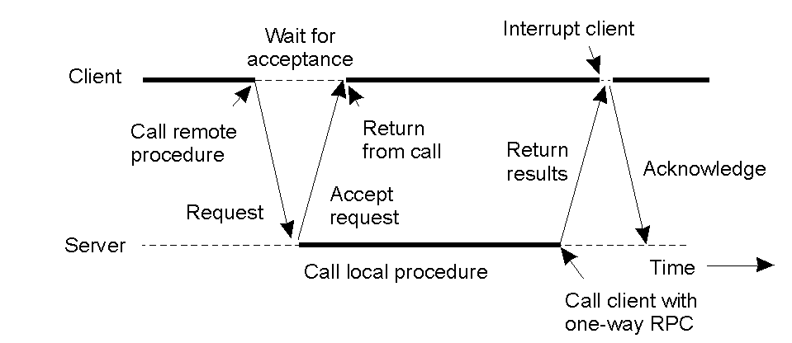
4.1 Remote Procedure Calls (10)
  Deferred synchronous RPC
A client and server interacting through two asynchronous RPCs
Distributed Systems
CSI3344

Slide 13
4.1 Remote Procedure Calls (11)
Deferred synchronous RPC
  It is a combination of two asynchronous RPCs.
  Is useful when there is a result to be returned from server but client is not prepared to wait for it and starts doing something else (e.g., remote computing).
One-way RPC
  Client does not wait for an acknowledgement from server and starts doing something else immediately after sending the request.
Distributed Systems
CSI3344

Slide 14
4.2 Remote (Object) Method Invocation (1)
Why using object?
  Object hides its internals from outside world by means of a well-defined interface
    allows objects to be easily replaced or adapted whereas the interface remains the same.
    (-- partial modification)
  An object encapsulates its data (state), and the operations (methods) on those data.
    Methods are made available through an interface.
    The data (or state) of the object can only be accessed by invoking methods through the interface.
    (-- simple and unique access)
Distributed Systems
CSI3344

Slide 15
4.2 Remote (Object) Method Invocation (2)
Why using object (cont…)?
  An object may have many interfaces. Likewise, an interface definition may be implemented by several objects.
  (-- multiple implementations)
  The separation between interfaces and the objects implementing these interfaces allows an interface to be placed at one machine, and the object itself to reside in another machine
  (-- distributed objects)
Distributed Systems
CSI3344

Slide 16
4.2 Remote (Object) Method Invocation (3)
What is RMI?
  RMI uses the same principle as RPC.
  Distributed objects are implemented using object-oriented programming languages (C++ or Java, etc.), rather than C.
  It uses method invocation to perform processes, instead of procedure call.
  Development of RMI applications is supported by many distributed object-based middleware, such as CORBA and DCOM
  (to be covered in week 11).
Distributed Systems
CSI3344

Slide 17
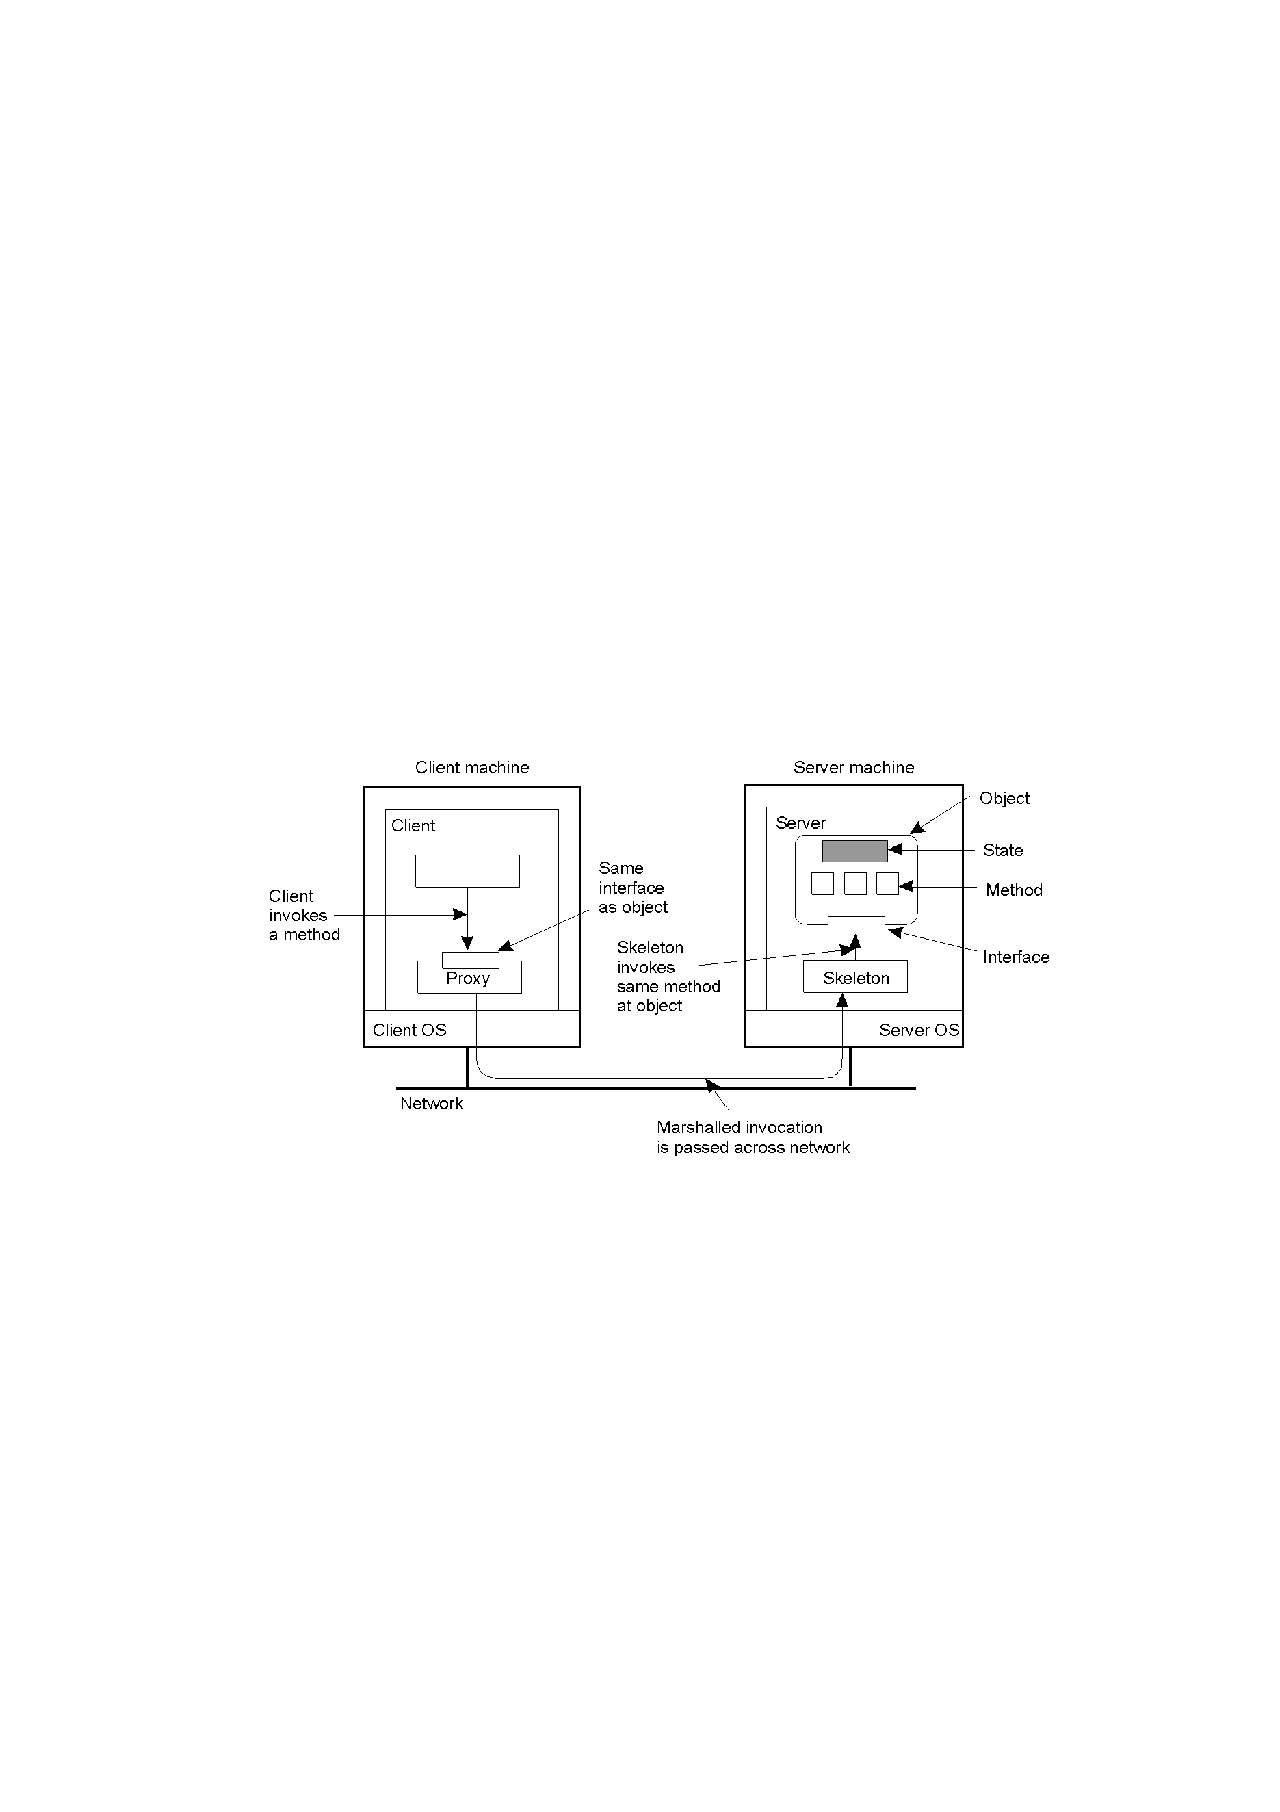
4.2 Remote (Object) Method Invocation (4)
General structure of RMI
Distributed Systems
CSI3344

Slide 18
4.2 Remote (Object) Method Invocation (5)
Some terms
  Proxy (client stub) is an implemented interface (on client machine) of a distributed object (on server machine).
    It marshals method invocations into message/s and unmarshals replied message/s to return the invocated results to the client.
    The remote object also has the same interface.
  Skeleton (server stub) unmarshals incoming invocation requests to proper method invocations at the object’s interface.
    It also marshals and forwards reply message/s to client proxy.
Distributed Systems
CSI3344

Slide 19
4.2 Remote (Object) Method Invocation (6)
RMI operation
4
1
2
3
Distributed Systems
CSI3344

Slide 20
4.2 Remote (Object) Method Invocation (7)
Steps in Making RMI (one-way)
Client invokes a method through the interface (handled by client Proxy) that is the same as that of the (remote) object.
Client proxy (stub) marshals the invocation into messages and then passes them to the server through network.
Skeleton (server stub) unmarshals incoming messages back to invocation and then passes it to the object through the object’s interface.
The object processes the incoming invocation by calling the right method to work on the input data.
Distributed Systems
CSI3344

Slide 21
4.3 Communication Systems (1)
Issues with RPCs and RMIs
  For RPC and RMI, we always assume the server side is executing at the time a client request is issued.
    - The interprocess will not happen if the server side is down.
  In any cases, after a request is issued, the client side will be blocked until the result or an acknowledgement from the server side is received.
    - It is not efficient!
Distributed Systems
CSI3344

Slide 22
4.3 Communication Systems (2)
One of the solutions
– Message-Queuing System (MQS) or Message-
Oriented Middleware (MOM)
  MQSs allow processes to exchange information, even if the other party is not executing at the time communication is initiated.
  Applications communicate by inserting messages in specific queues.
  Each application has its own private queue to which other applications can send messages.
Distributed Systems
CSI3344

Slide 23
4.3 Communication Systems (3)
  – Message-Queuing System (MQS) or Message-
  Oriented Middleware (MOM) (cont…)
  A sender is generally given only the guarantees that its message will be inserted in the recipient’s queue eventually, but no guarantees when or if the message will actually be read.
  Once a message has been deposited in a queue, it will remain there until it is removed, irrespective of whether its sender or receiver is executing.
  MQSs provide extensive support for persistent asynchronous communication, by offering intermediate-term storage capacity for messages.
Distributed Systems
CSI3344

Slide 24
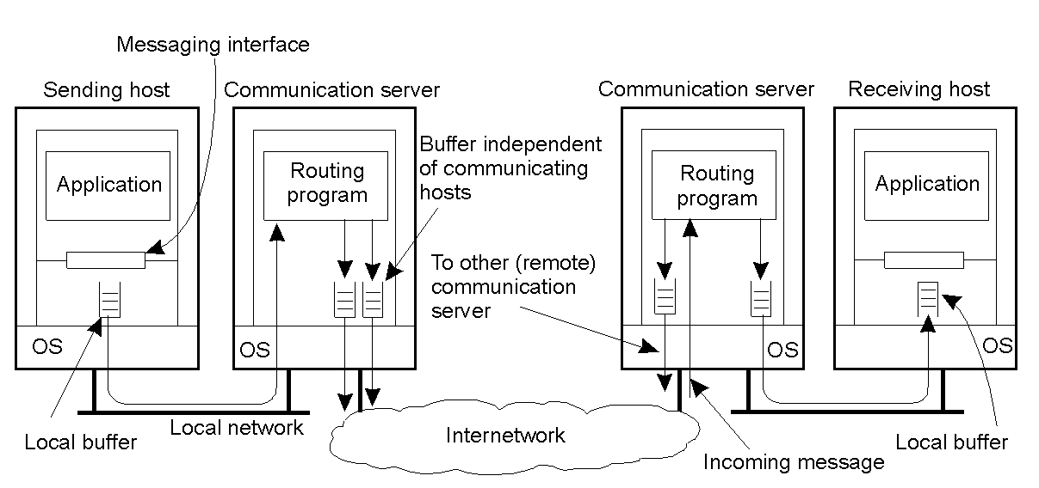
4.3 Communication Systems (4)
General organization of message-queuing systems
Distributed Systems
CSI3344

Slide 25
4.3 Communication Systems (5)
Some terms
Persistent communication – a message is stored in the communication server as long as the server delivers it to the receiver.
Transient communication - a message is stored in the communication server only as long as the sending and receiving applications are executing.
  - In other words, the message is discarded by the communication server as soon as it cannot be delivered at the next server, or at the receiver.
Distributed Systems
CSI3344

Slide 26
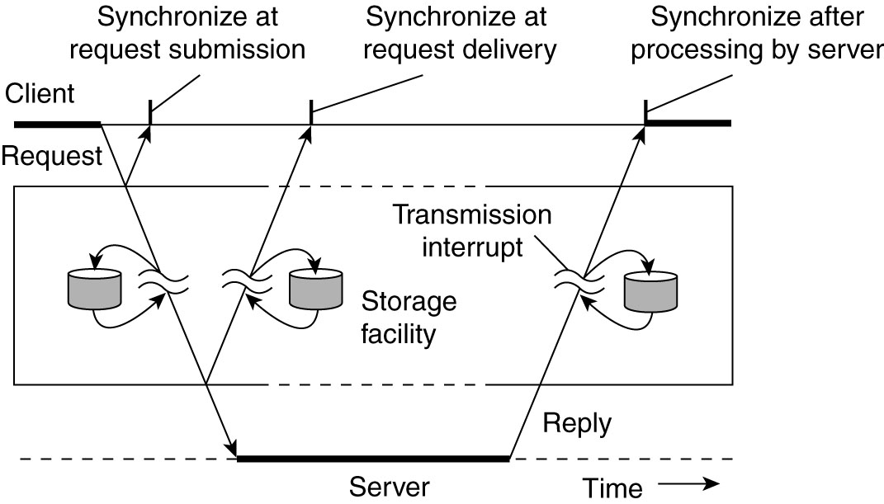
4.3 Communication Systems (6)
Persistent Vs. Transient communication
Places for synchronization:
  -- At request submission
  -- At request delivery
  -- After request processed
Distributed Systems
CSI3344

Slide 27
4.3 Communication Systems (7)
Some terms (cont…)
Asynchronous communication - a sender continues immediately after issuing its message for transmission.
Synchronous communication - a sender is blocked until its message is stored in the receiving host, or actually delivered to the receiver.
  Generally, client/server computing is based on a model of transient synchronous communication, i.e.,
    Client and servers have to be active at the time of communication;
    Client issues request and blocks itself until it receives reply;
    Server essentially waits only for incoming requests, and subsequently processes them.
Distributed Systems
CSI3344

Slide 28
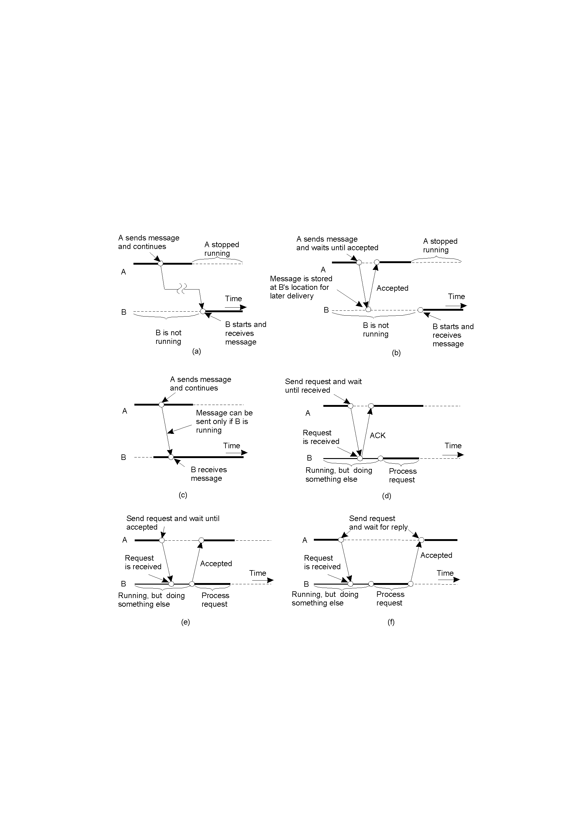
4.3 Communication Systems (8)
Classification of message-queuing systems (1)
  Persistent asynchronous communication
  Persistent synchronous communication
Distributed Systems
CSI3344

Slide 29
4.3 Communication Systems (9)
Classification of message-queuing systems (2)
  Transient asynchronous communication
  Receipt-based transient synchronous communication
Distributed Systems
CSI3344

Slide 30
4.3 Communication Systems (10)
Classification of message-queuing systems (3)
  Delivery-based transient synchronous communication
  Response-based transient synchronous communication
Distributed Systems
CSI3344

Slide 31

4.3 Communication Systems (11)
Message-Queuing models
Four combinations with respect to the execution mode of send and receiver
(a) Both sender and receiver execute during the entire transmission of a message
(b) Only sender is executing, while receiver is passive (i.e. message delivery impossible)
(c) Receiver can read message, but sender was not necessarily executing
(d) System is storing (possibly transmitting) messages even while sender & receiver are passive
Distributed Systems
CSI3344

Slide 32
Major Points
Steps of a Remote Procedure Call
Asynchronous RPC
Deferred synchronous RPC
General structure of RMI
RMI operations
Problems with RPCs and RMIs
Major features of message-queuing systems or Message-Oriented Middleware (MOM)
Classification of message-queuing systems
Message-Queuing models
Reading Guide
DSPP: Chapter4: Sections 4.2, 4.3
Distributed Systems
CSI3344

